Slide 1
BIKE SHARE PREDICTION ANALYSIS
GROUP 13

Slide 2

GROUP 13
LIN, Hongzhou (Hong)
LIN, Yiqi (Regina)
AJWAD, Habeeb Ahamed
LIU, Xiaoning (Eric)
CHEN, Yihua (Alisa)

Slide 3





TABLE OF CONTENT
Introduction
Model2
Conclusion
Model1
Model3
Introduction
Model 1
Model 2
Model 3
Conclusion

Slide 4
OBJECTIVES
BIKE USAGES GIVEN DIFFERENT
Our objective is to predict the usage of bikes under different conditions.
Numerical variables: temperature, humidity, windspeed,
Categorical variables: seasons, working day, holiday, weekday, weather
Introduction
Model 1
Model 2
Model 3
Conclusion

Slide 5
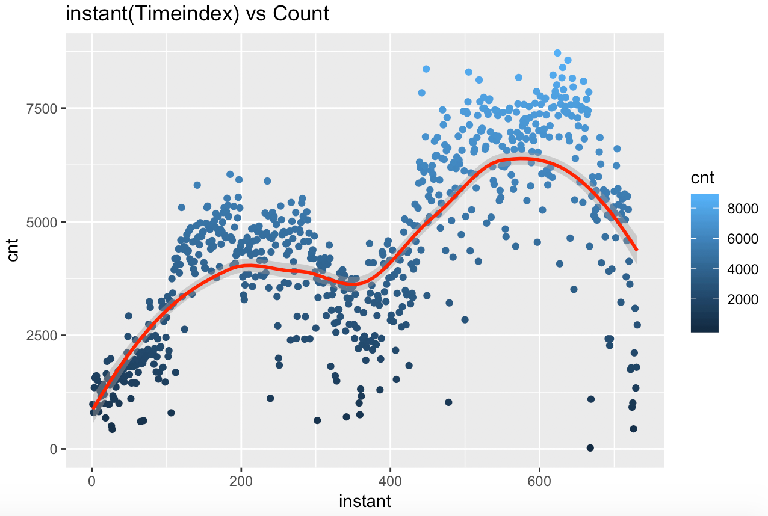
SEASONAL PATTERN
Introduction
Model 1
Model 2
Model 3
Conclusion

Slide 6
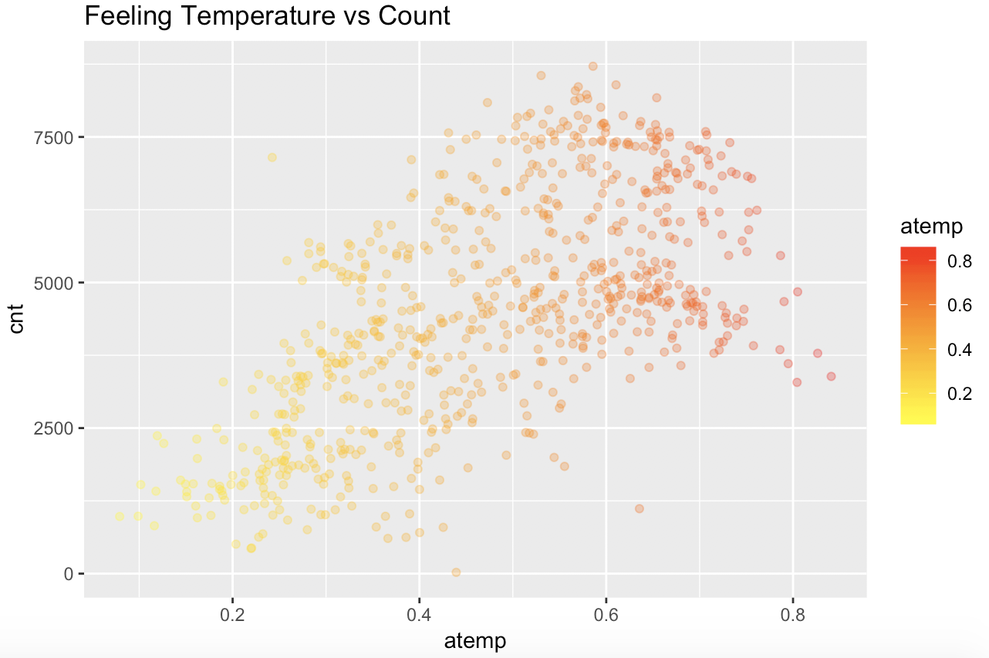
TEMPERATURE VS BIKE
USAGE
Introduction
Model 1
Model 2
Model 3
Conclusion

Slide 7
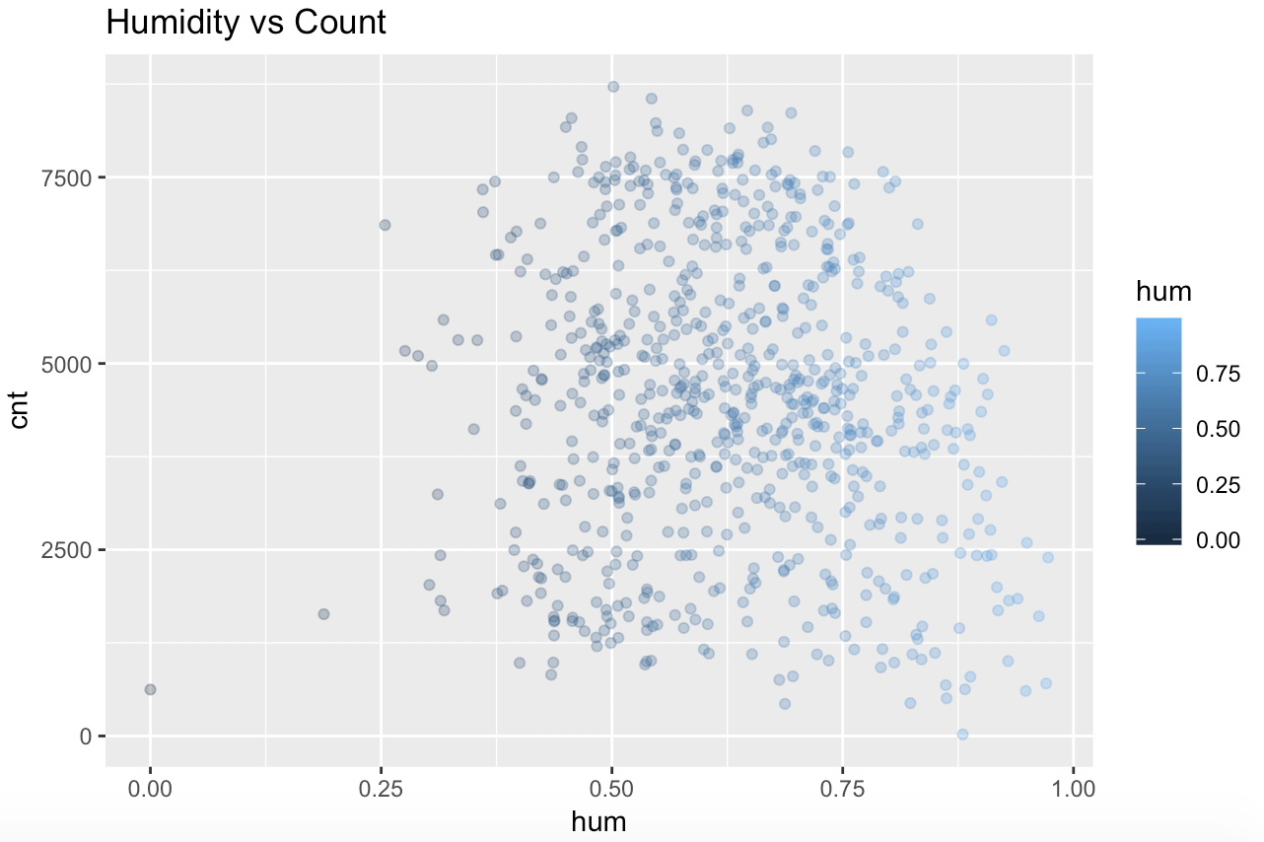
HUMIDITY VS BIKE USAGE
Introduction
Model 1
Model 2
Model 3
Conclusion

Slide 8
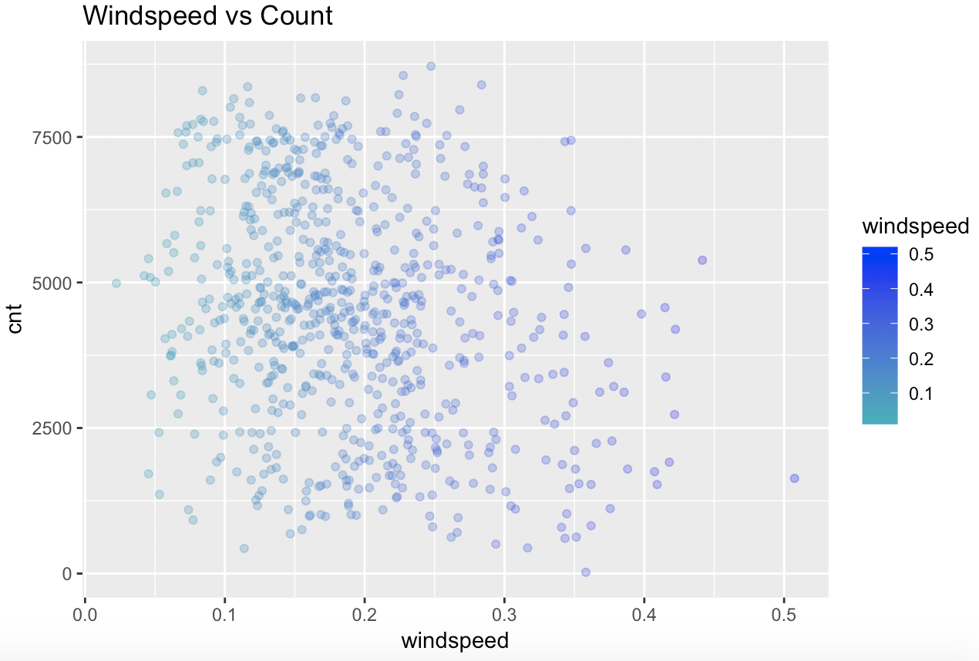
WINDSPEED VS BIKE USAGE
Introduction
Model 1
Model 2
Model 3
Conclusion

Slide 9
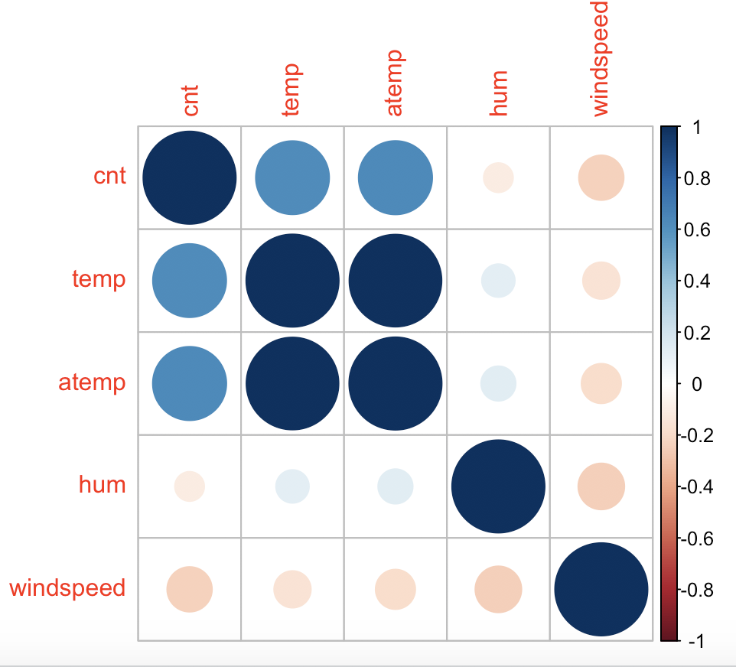
CORRELATION PLOT
Introduction
Model 1
Model 2
Model 3
Conclusion

Slide 10
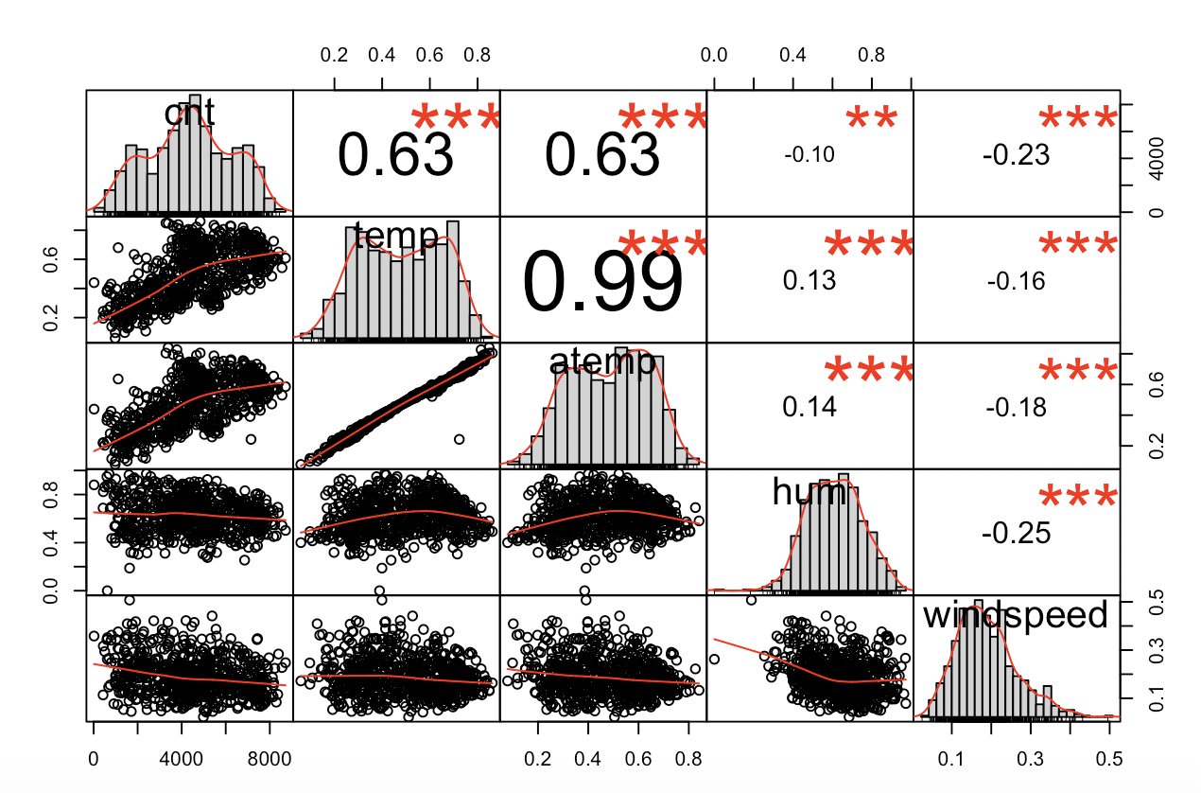
CORRELATION
Introduction
Model 1
Model 2
Model 3
Conclusion

Slide 11
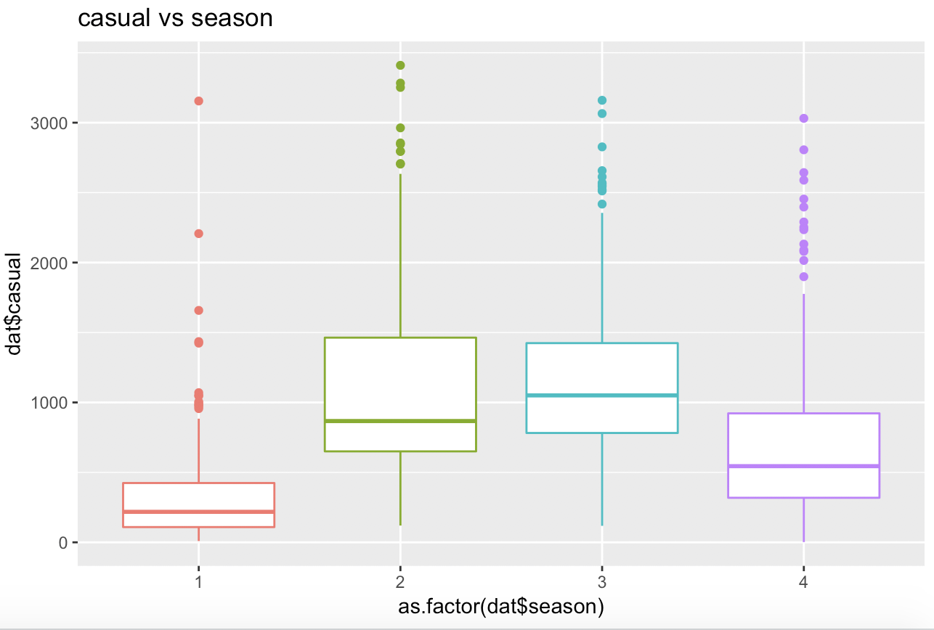
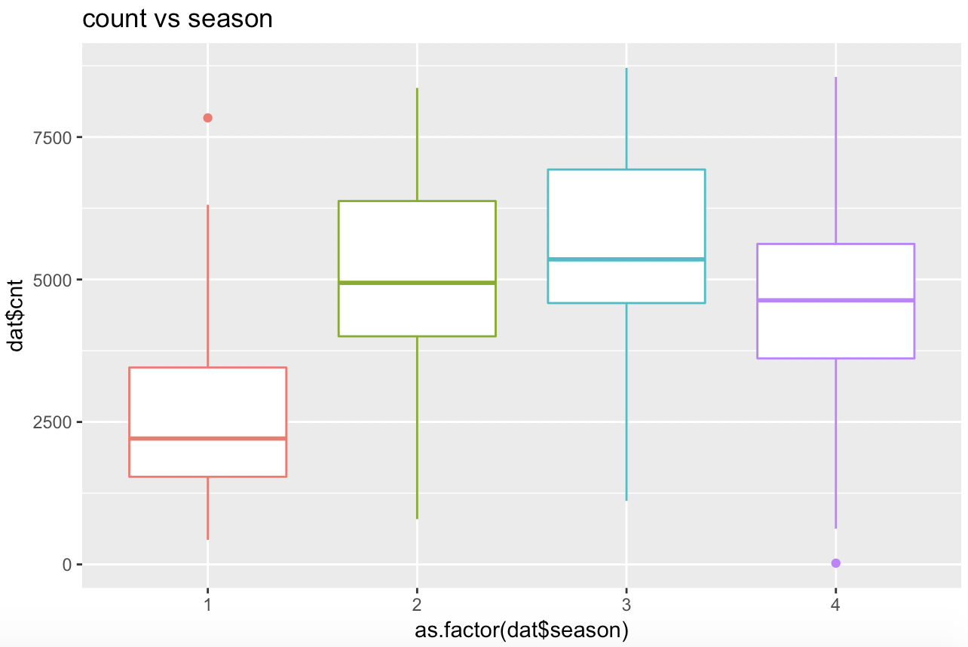
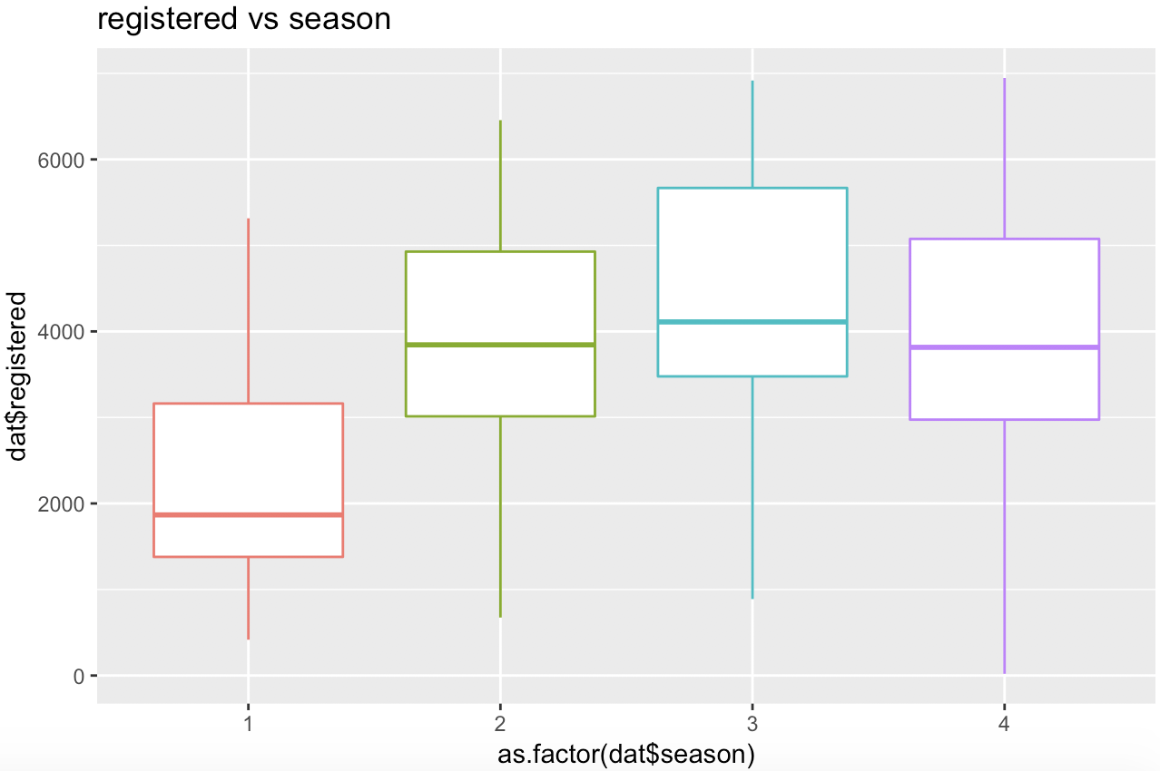
SEASON
Introduction
Model 1
Model 2
Model 3
Conclusion

Slide 12
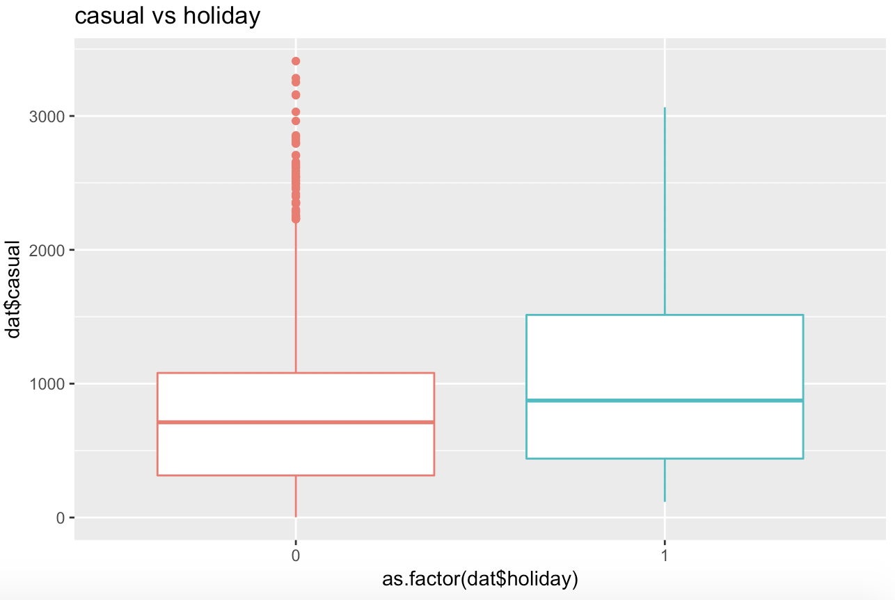
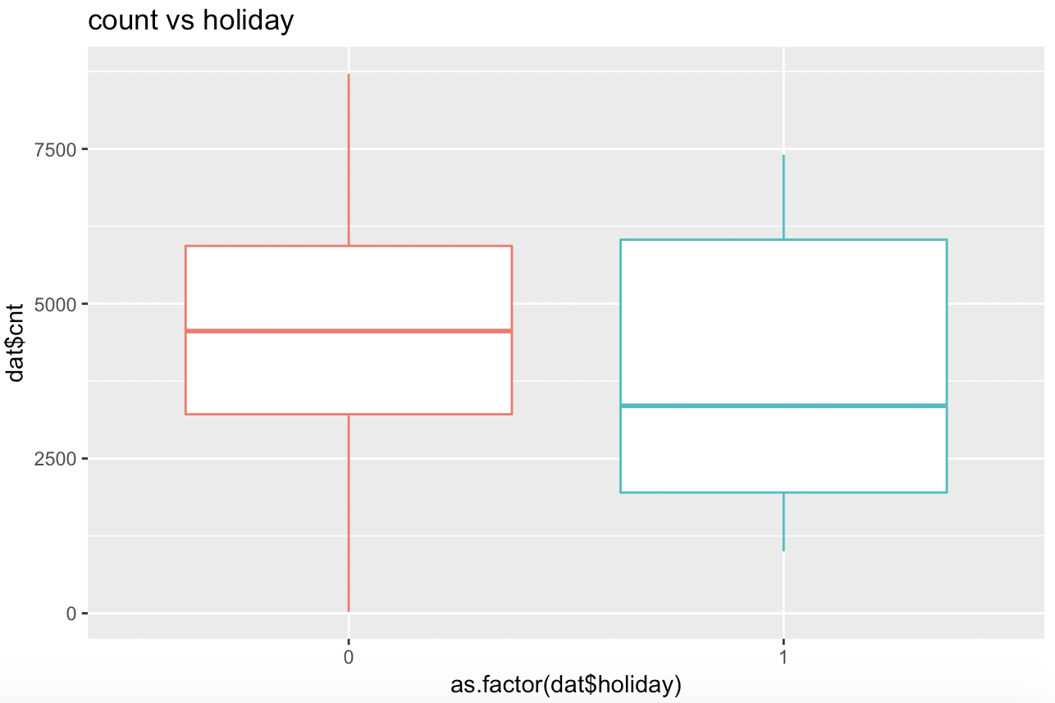
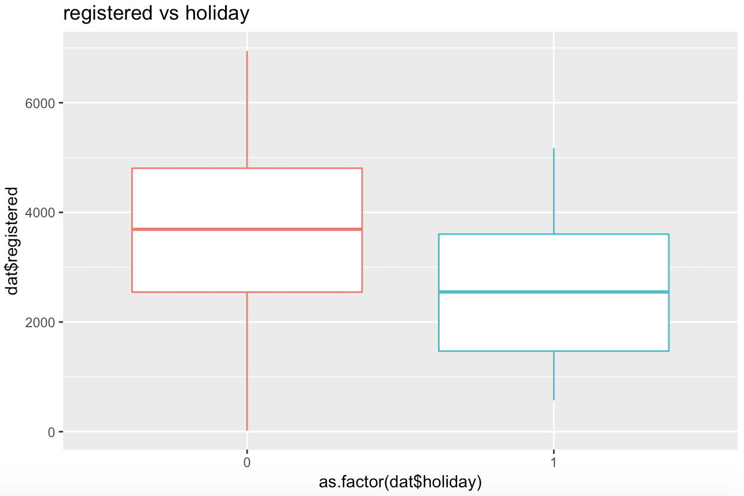
HOLIDAY
Introduction
Model 1
Model 2
Model 3
Conclusion

Slide 13
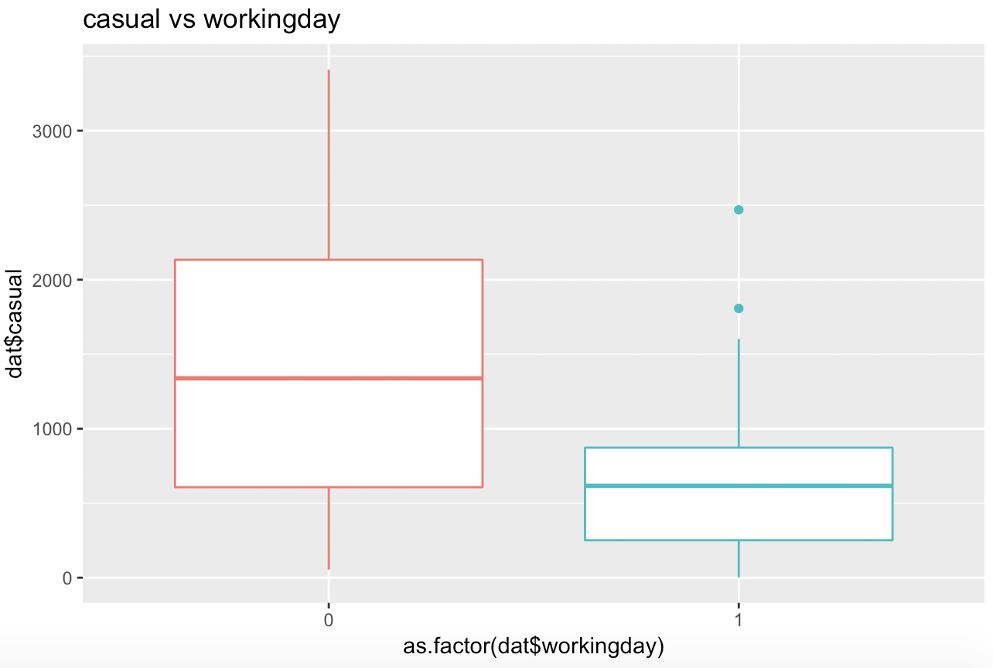
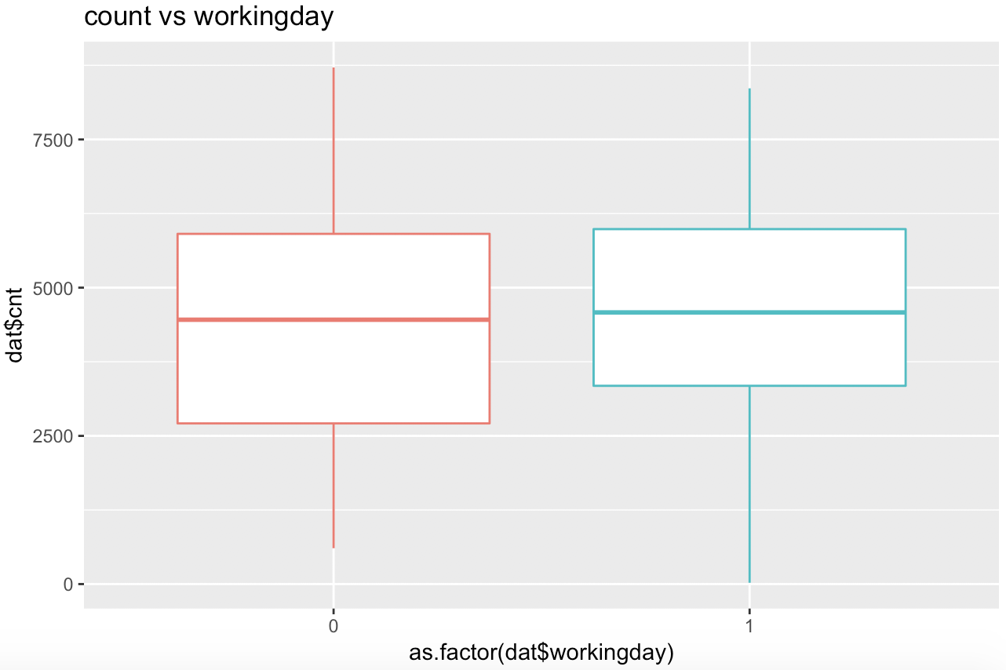
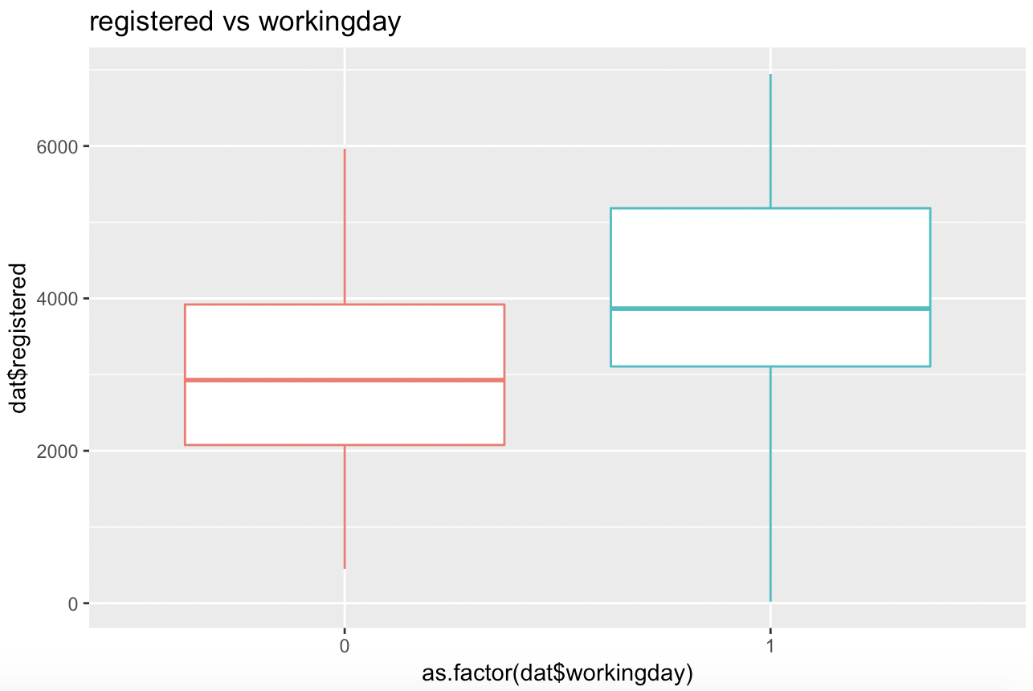
WORKING DAY
Introduction
Model 1
Model 2
Model 3
Conclusion

Slide 14
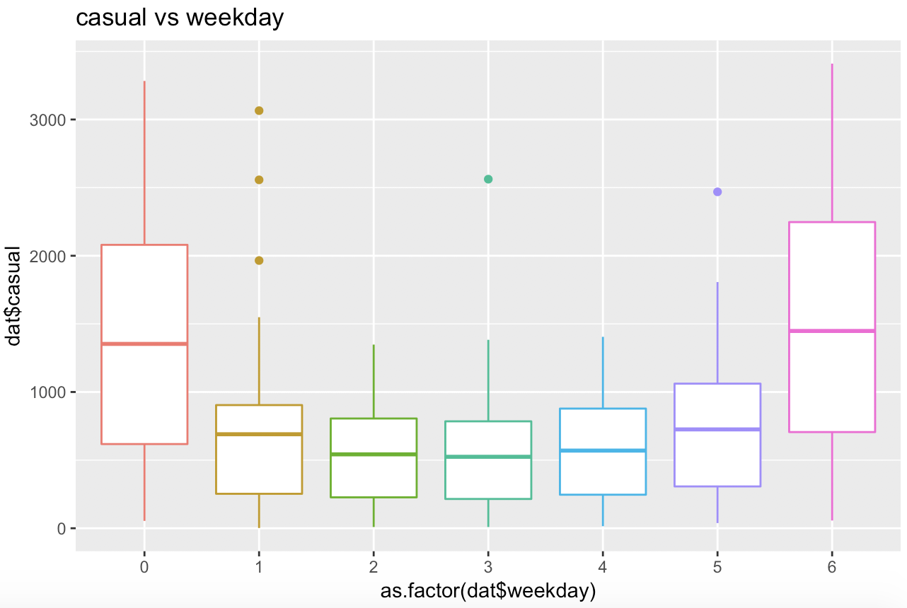
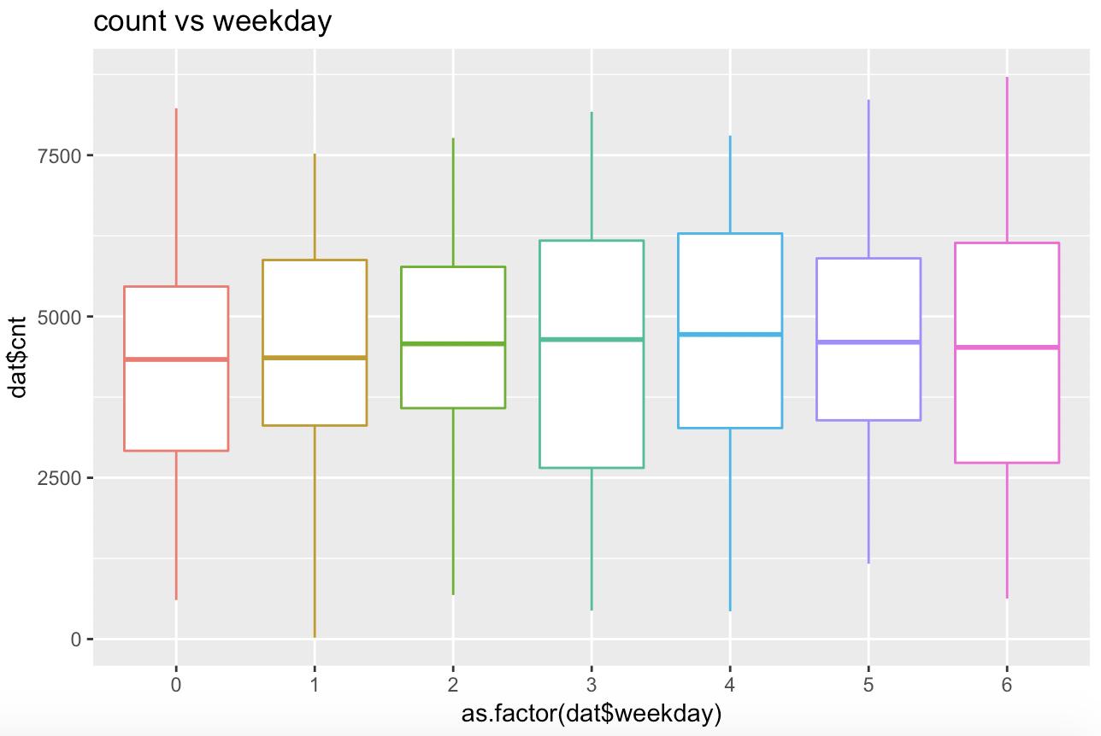
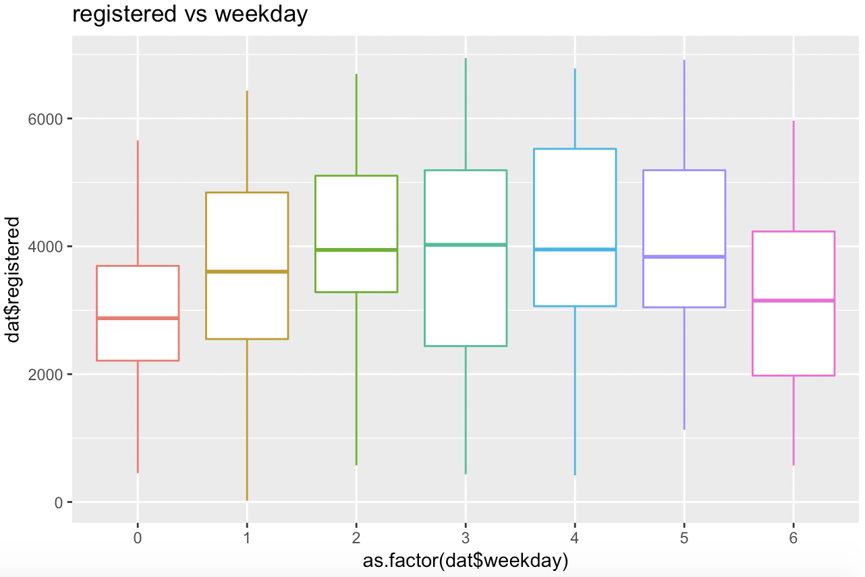
WEEKDAY
Introduction
Model 1
Model 2
Model 3
Conclusion

Slide 15
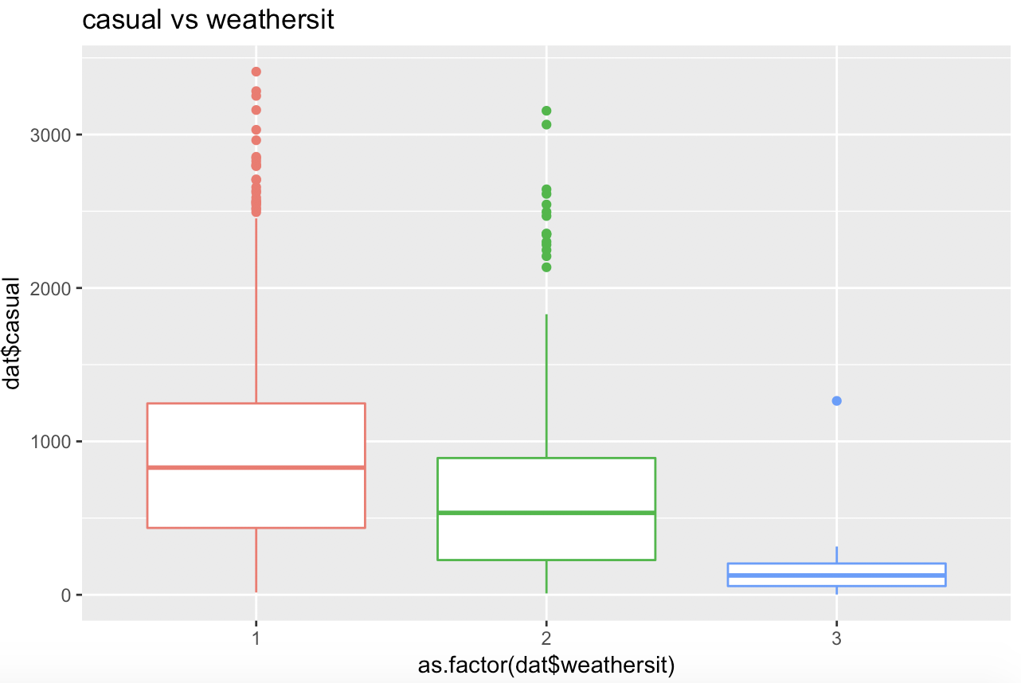
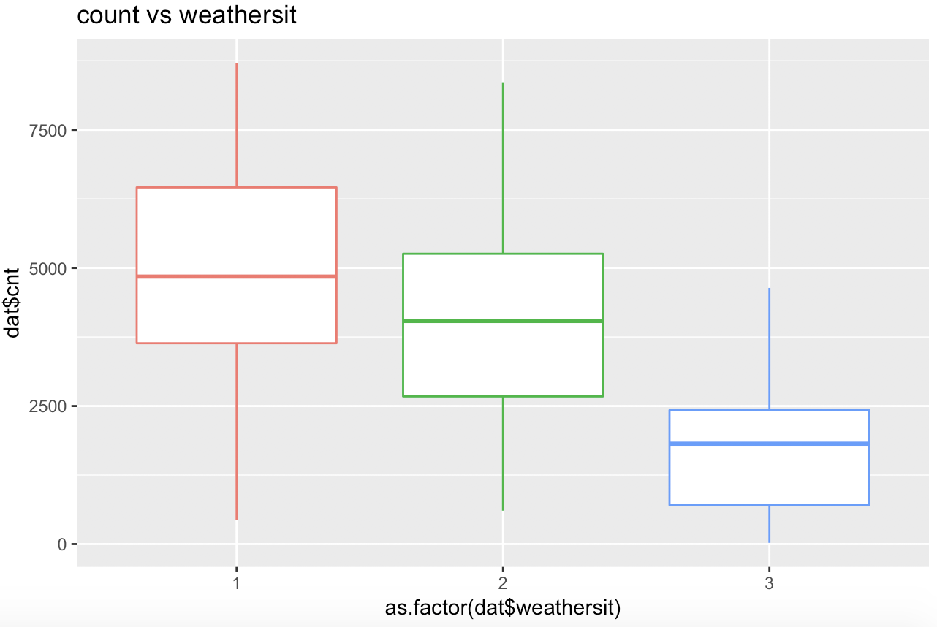
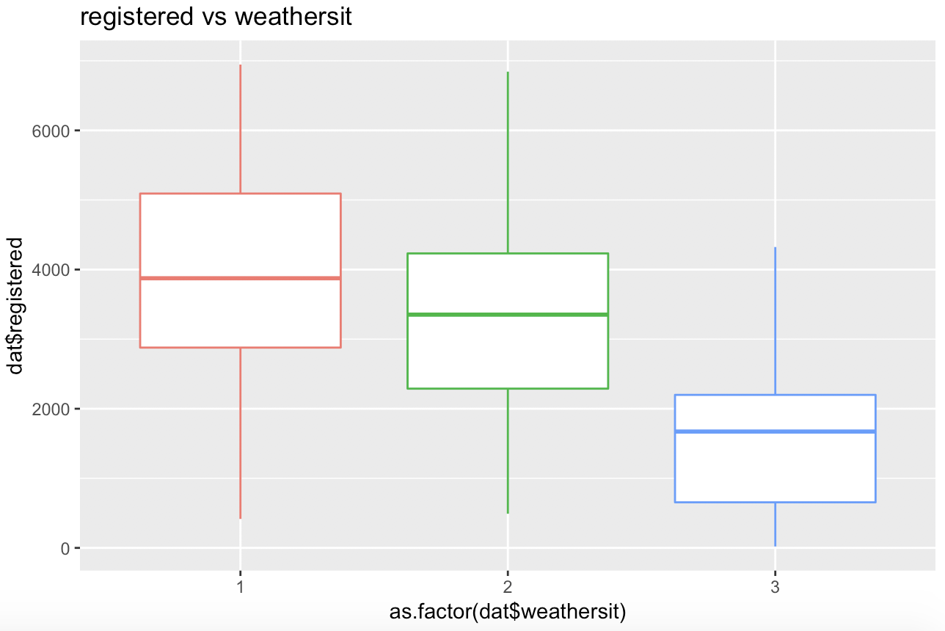
WEATHER
Introduction
Model 1
Model 2
Model 3
Conclusion

Slide 16
Model1
Additive Model

Slide 17
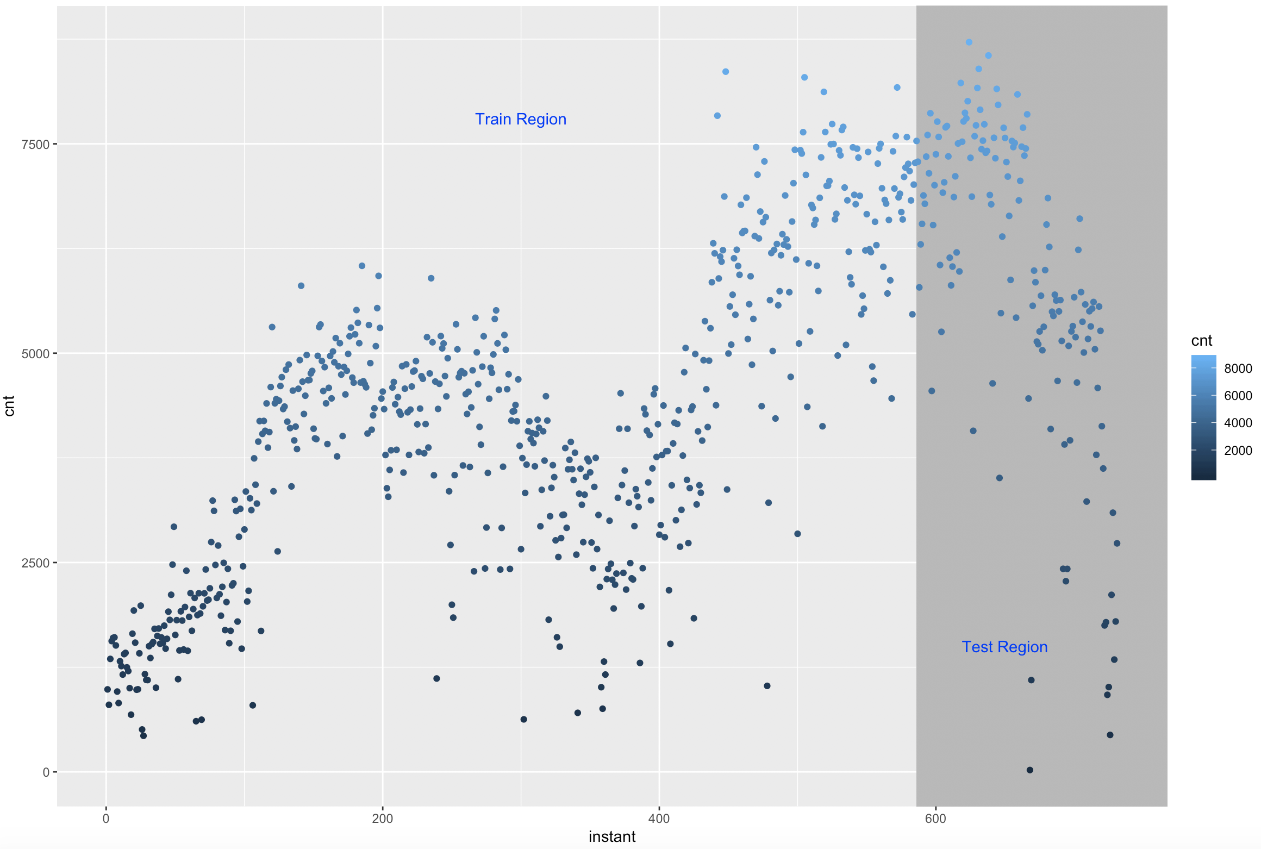

SPLIT DATA
Seasonal Pattern
Y is normal distributed
Time Series
Additive Model
Increasing Trend
Introduction
Model 1
Model 2
Model 3
Conclusion

Slide 18
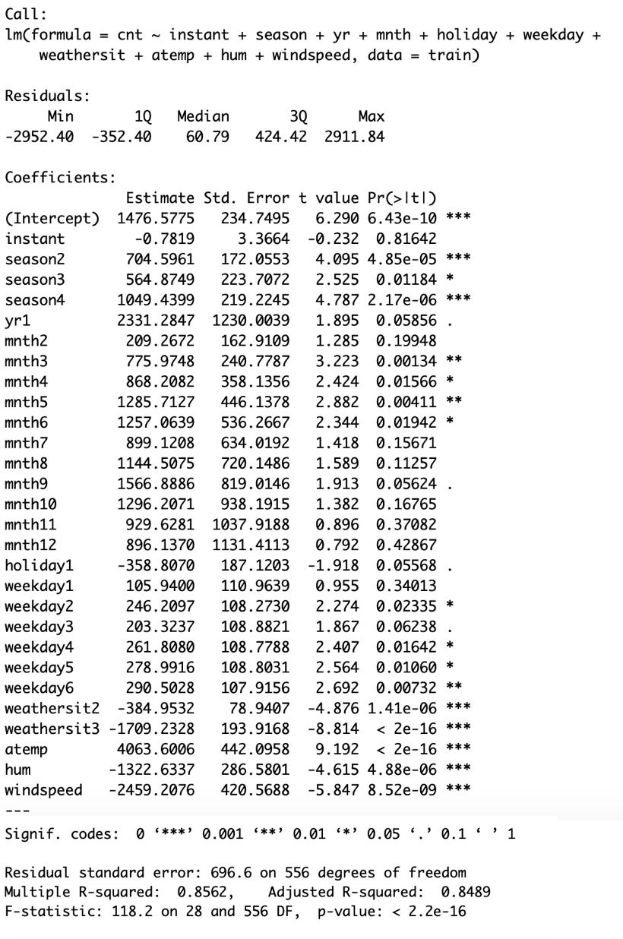

MODEL 1 FULL MODEL
Overall Model is useful
Introduction
Model 1
Model 2
Model 3
Conclusion

Slide 19
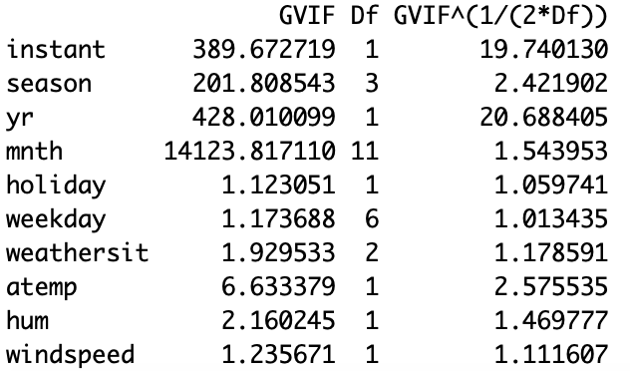
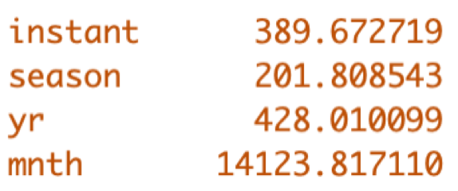

MODEL 1 FULL MODEL
multicollinearity problem
Introduction
Model 1
Model 2
Model 3
Conclusion

Slide 20
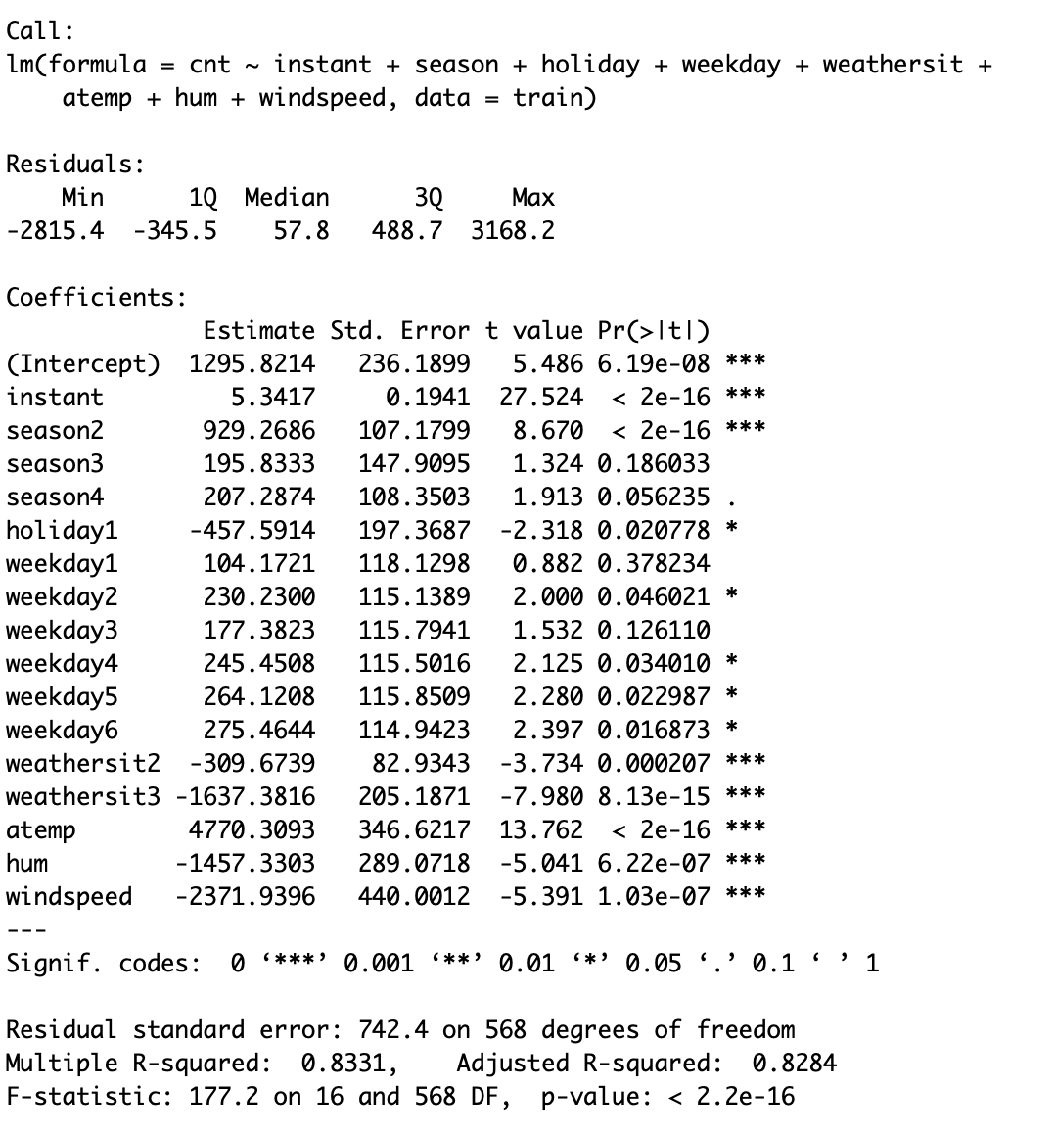

MODEL 1.1
Delete “yr” and “mnth”
Introduction
Model 1
Model 2
Model 3
Conclusion

Slide 21
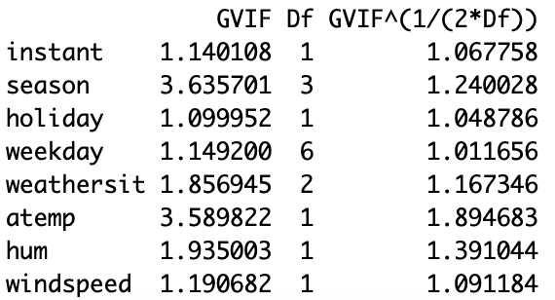
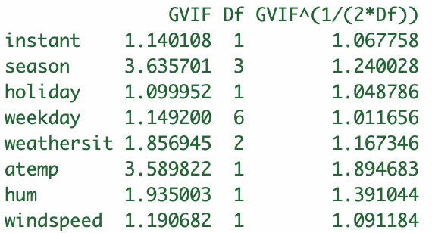

MODEL 1.1
multicollinearity problem fixed
Introduction
Model 1
Model 2
Model 3
Conclusion

Slide 22
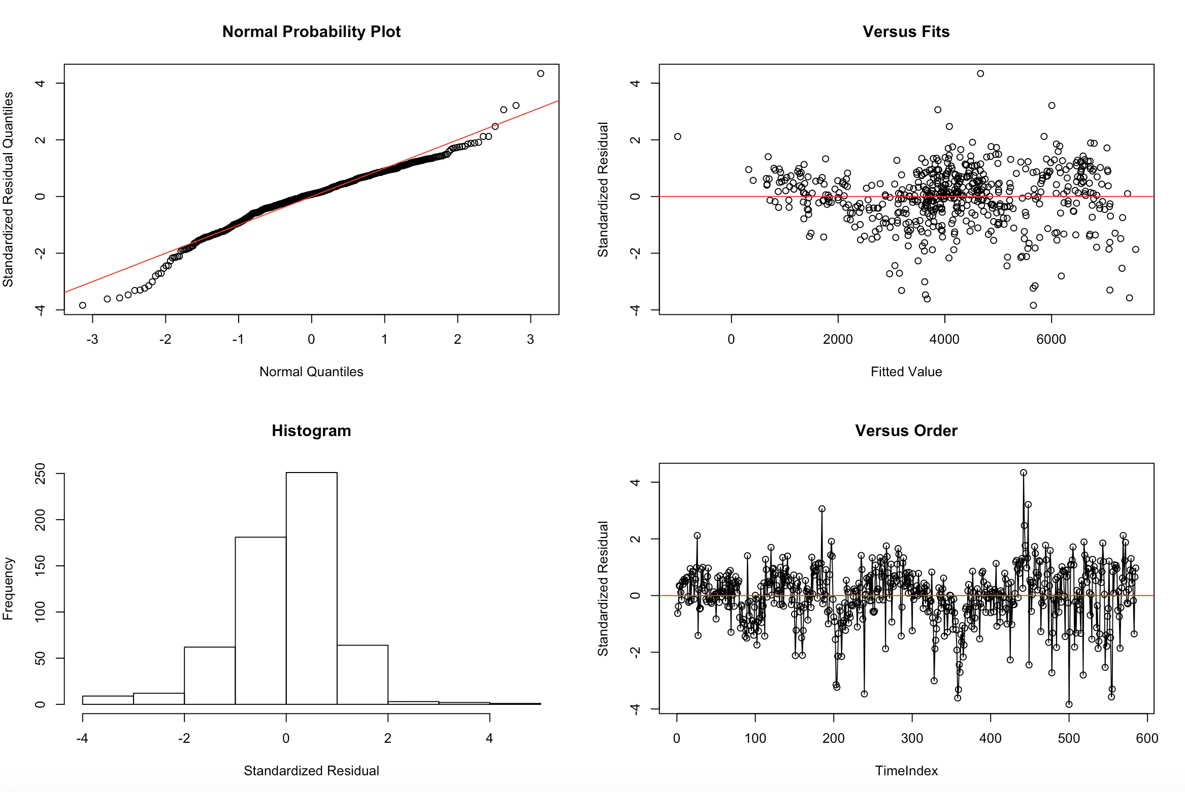


MODEL 1.1 DIAGNOSTICS
Introduction
Model 1
Model 2
Model 3
Conclusion

Slide 23
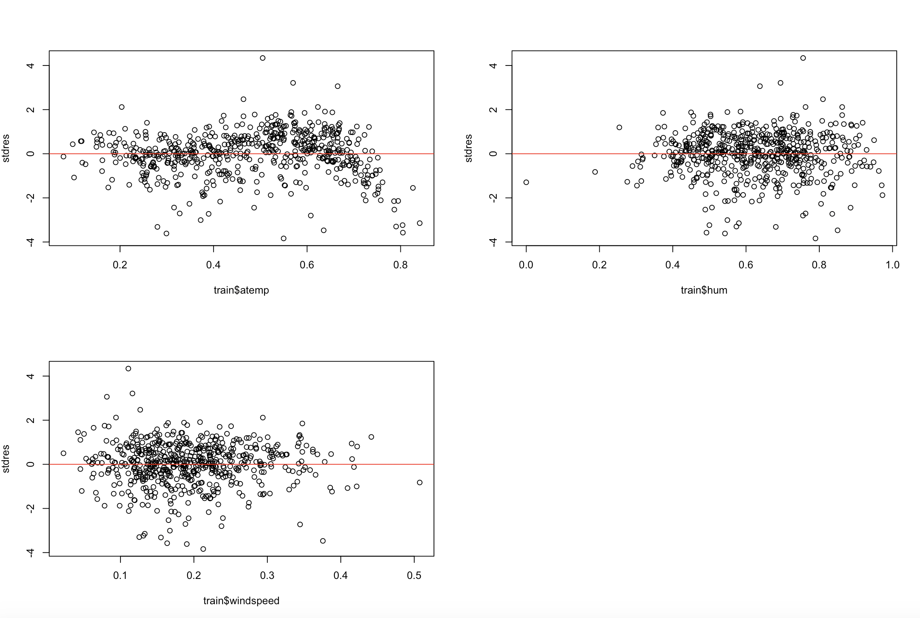
MODEL 1.1 RESIDUAL PLOT NUMERIC
Introduction
Model 1
Model 2
Model 3
Conclusion

Slide 24
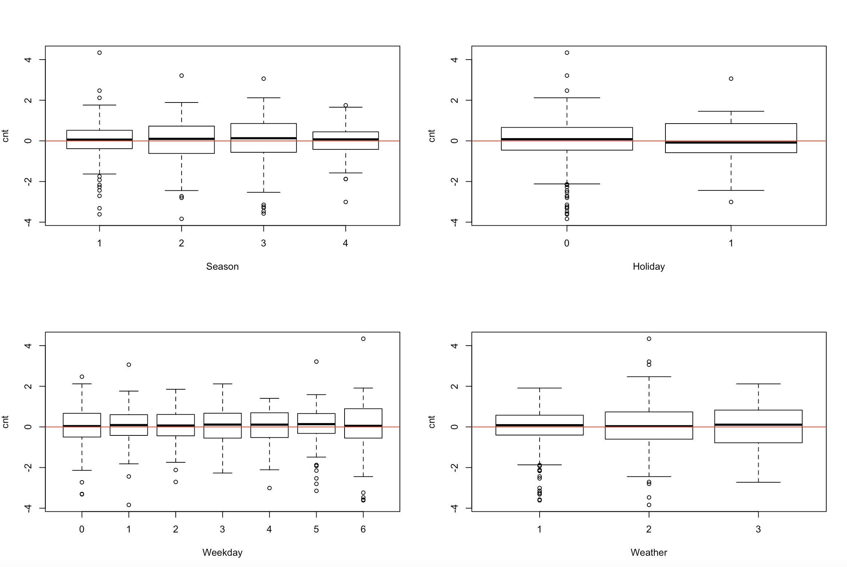
MODEL 1.1 RESIDUAL PLOT CATEGORICAL
Introduction
Model 1
Model 2
Model 3
Conclusion

Slide 25
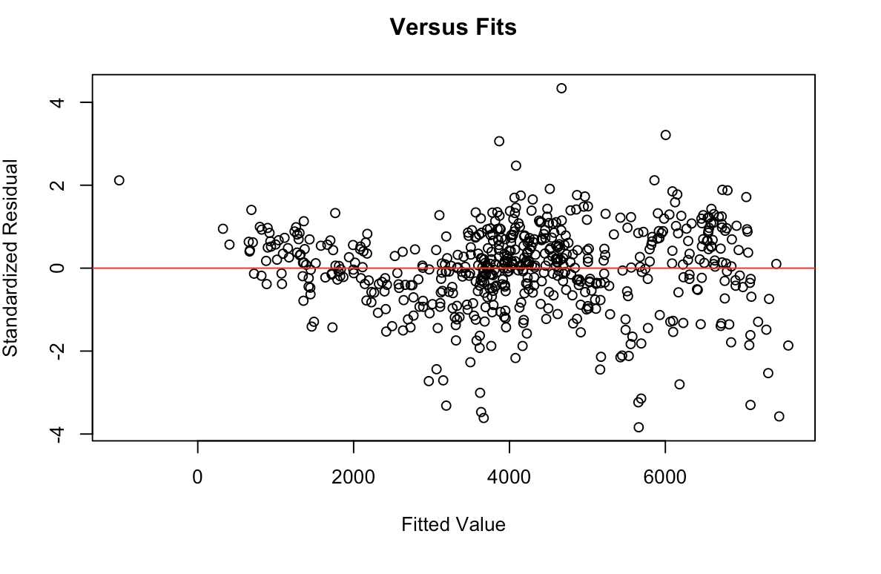
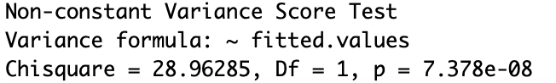
MODEL 1.1 RESIDUAL PLOT
BP-TEST
The constant variance assumption is violated.
Introduction
Model 1
Model 2
Model 3
Conclusion

Slide 26
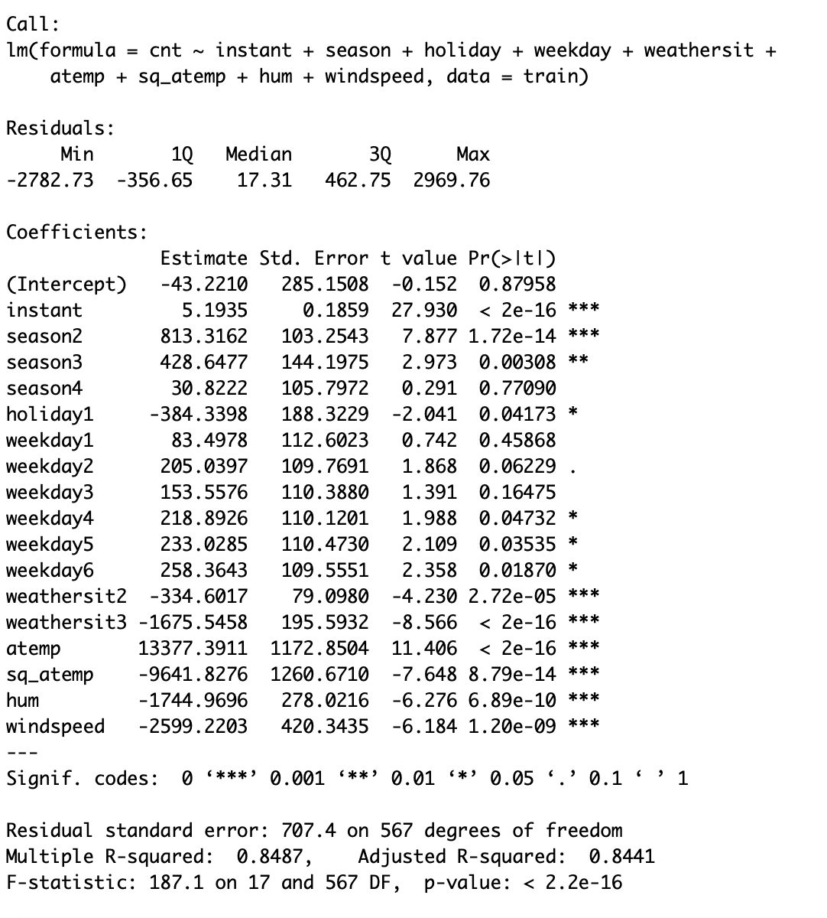
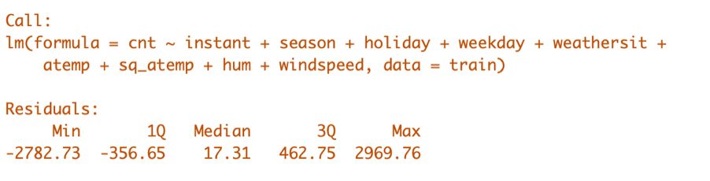
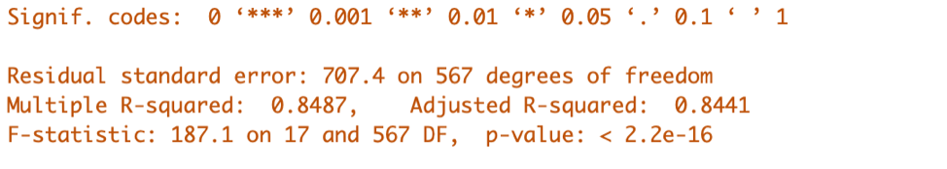
MODEL 1.2
Higher Order Term
Introduction
Model 1
Model 2
Model 3
Conclusion

Slide 27
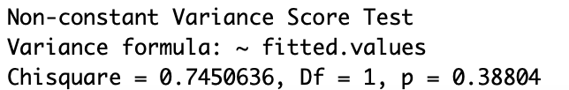
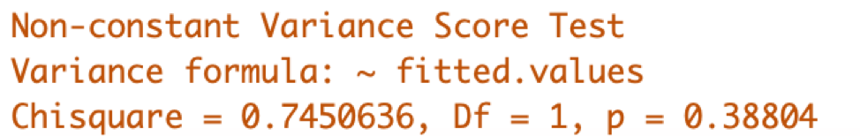
MODEL 1.2 BP-TEST
The constant variance assumption is satisfied.
Introduction
Model 1
Model 2
Model 3
Conclusion

Slide 28
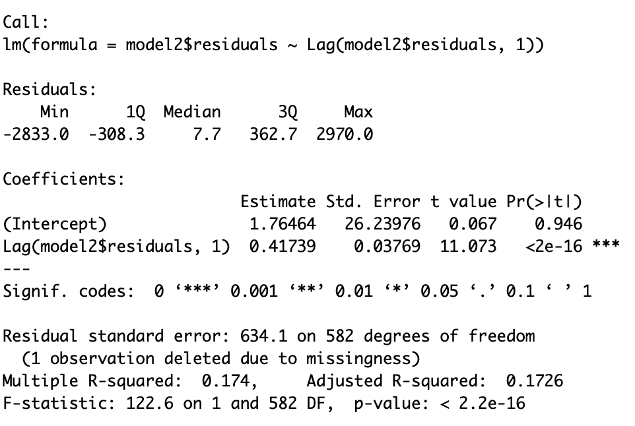
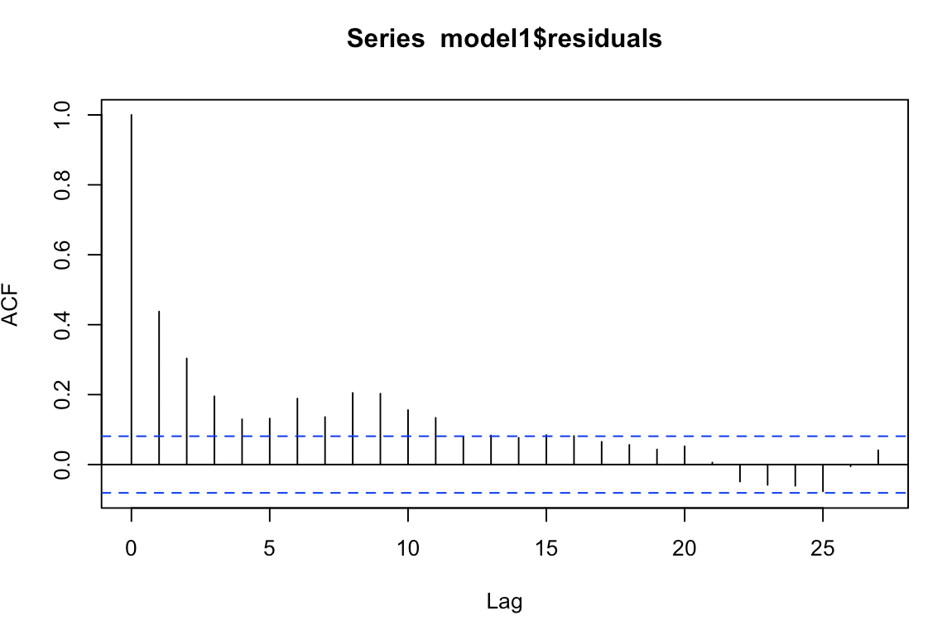
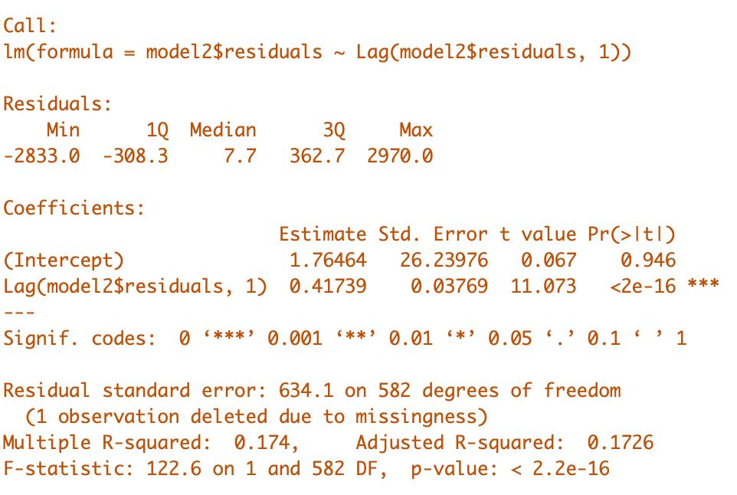
MODEL 1.2 COCHRANE-ORCUTT TEST
The independence assumption is violated.
Introduction
Model 1
Model 2
Model 3
Conclusion

Slide 29
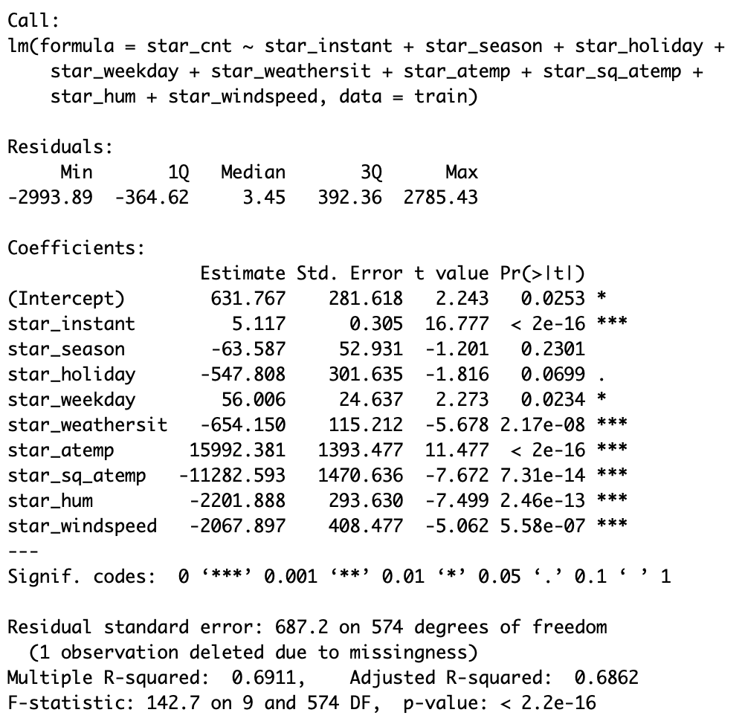
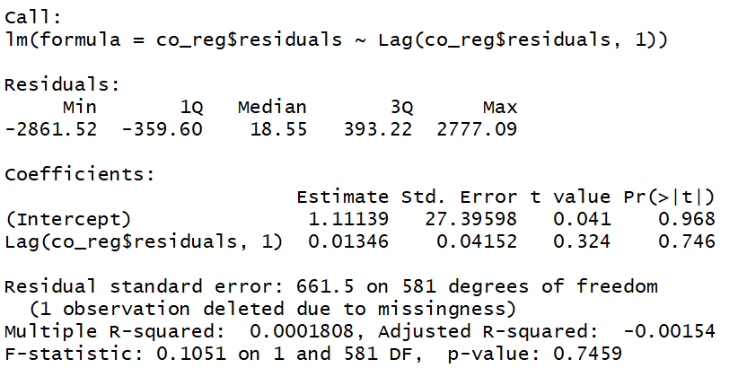
MODEL 1.2 COCHRANE-ORCUTT PROCEDURE
The independence assumption is satisfied.
“Season” and “holiday” are not significant.
Introduction
Model 1
Model 2
Model 3
Conclusion

Slide 30
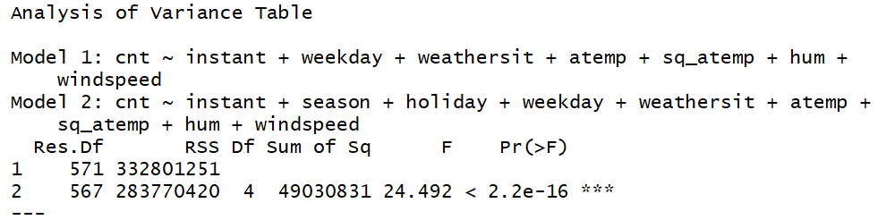
MODEL 1.2 ANOVA
The model with “season” and “holiday” is statistically better.
Introduction
Model 1
Model 2
Model 3
Conclusion

Slide 31
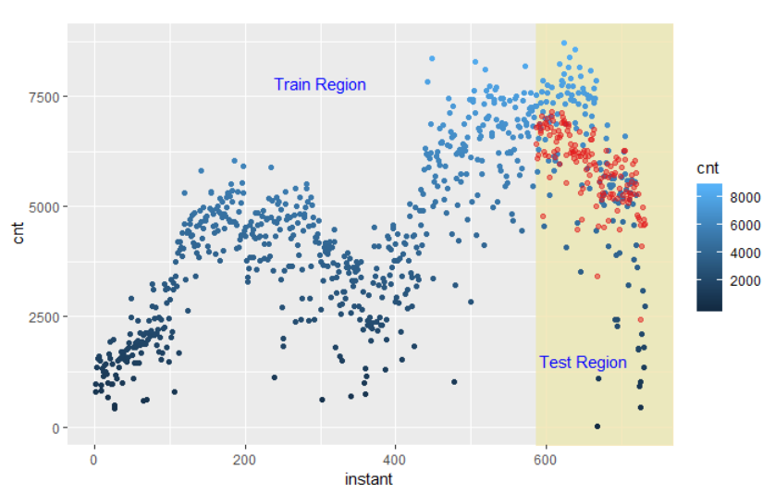
MODEL 1.2 PREDICTION
RMSE:1299; MAD: 963
Introduction
Model 1
Model 2
Model 3
Conclusion

Slide 32
Model2
MLR

Slide 33

MODEL 2
Year 2
Year 1
Introduction
Model 1
Model 2
Model 3
Conclusion

Slide 34
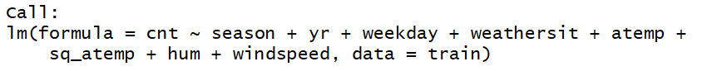
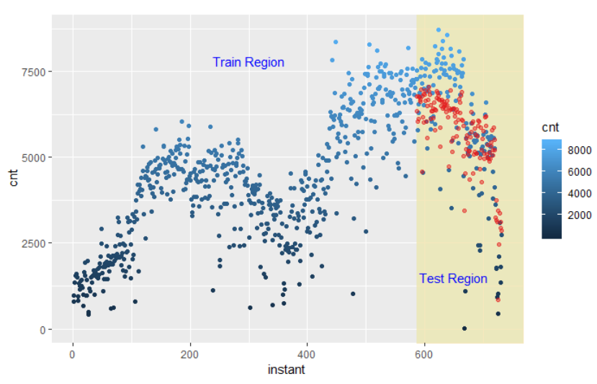
MODEL 2
PREDICTION
Model 1 (additive model)
RMSE: 1299; MAD: 963
Model 2 (MLR model)
RMSE: 1096; MAD: 826
Introduction
Model 1
Model 2
Model 3
Conclusion

Slide 35
Model3
Combined

Slide 36
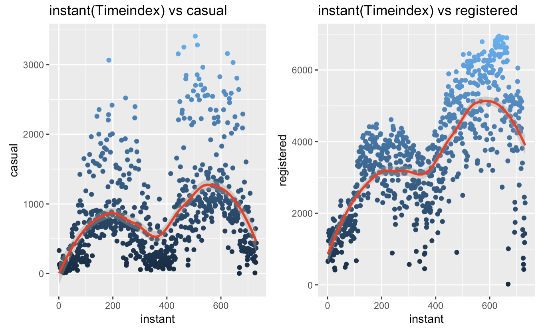

MODEL 3 CASUAL VS REGISTERED
Casual
Registered
Introduction
Model 1
Model 2
Model 3
Conclusion

Slide 37
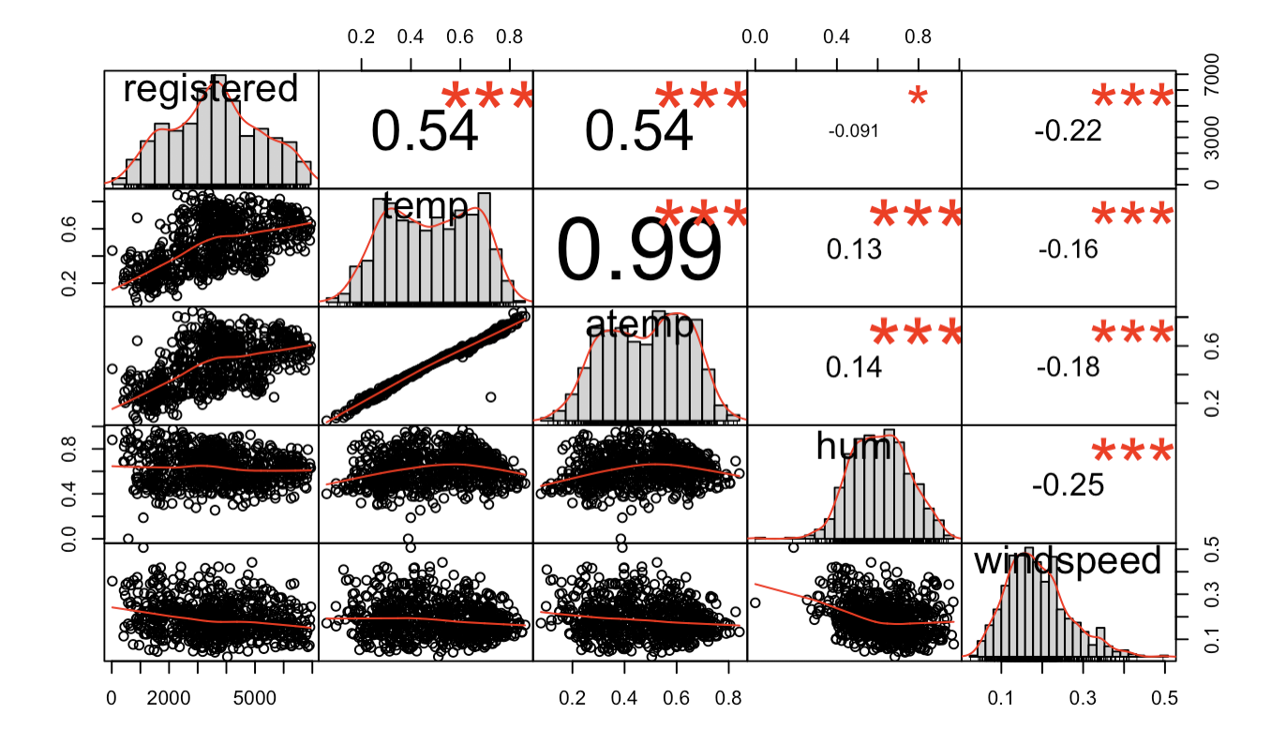
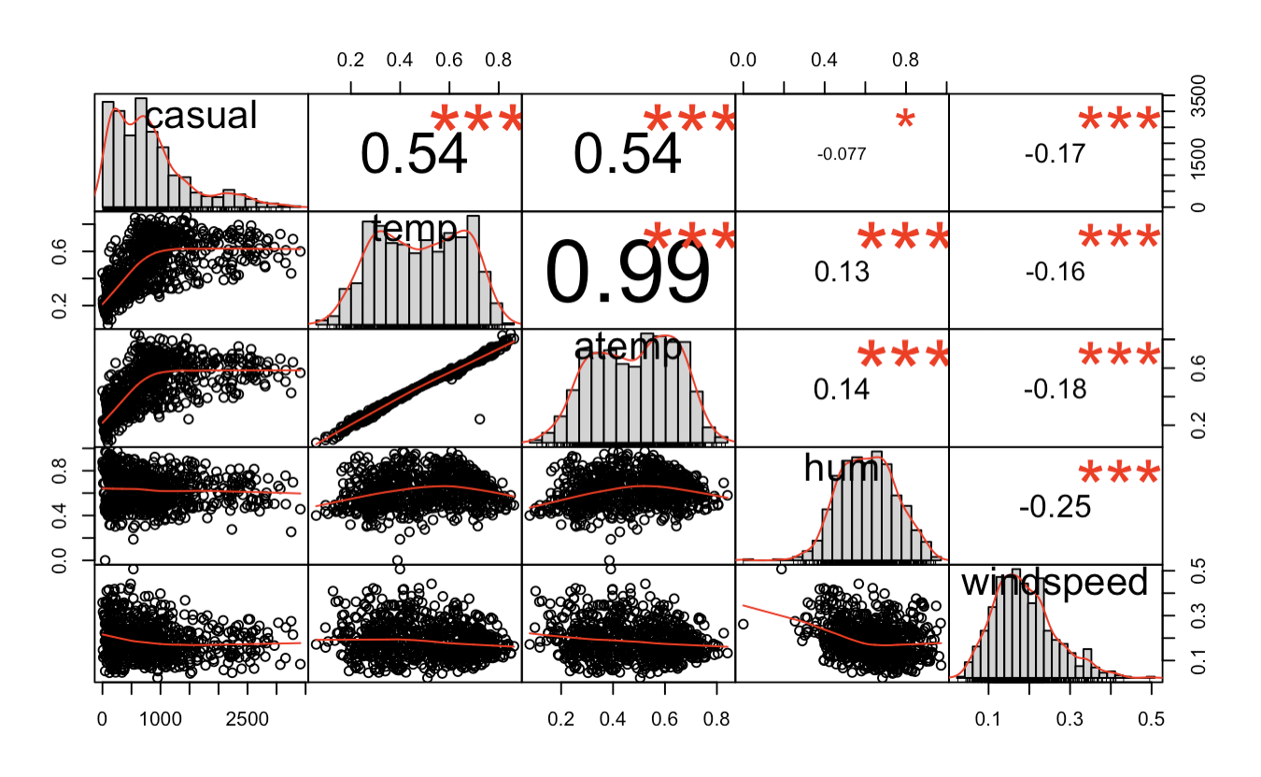
MODEL 3 CASUAL VS REGISTERED
Introduction
Model 1
Model 2
Model 3
Conclusion

Slide 38
MODEL 3 CASUAL VS REGISTERED
Introduction
Model 1
Model 2
Model 3
Conclusion

Slide 39

MODEL 3.1 REGISTERED
Overall Model is useful
Introduction
Model 1
Model 2
Model 3
Conclusion

Slide 40

MODEL 3.2 REGISTERED
Higher Order Term
Introduction
Model 1
Model 2
Model 3
Conclusion

Slide 41

MODEL 3.2
RMSE: 927; MAD: 684
Introduction
Model 1
Model 2
Model 3
Conclusion

Slide 42

MODEL 3.1 CASUAL
Overall Model is useful
Introduction
Model 1
Model 2
Model 3
Conclusion

Slide 43


MODEL 3.1 CASUAL PREDICTION
RMSE: 317; MAD: 217
Introduction
Model 1
Model 2
Model 3
Conclusion

Slide 44

MODEL 3.1 COMBINED PREDICTION
RMSE: 1007; MAD: 757
Introduction
Model 1
Model 2
Model 3
Conclusion

Slide 45
Conclusion
Prediction and Explanation

Slide 46

COMPARISON
 | Model1(Additive Model) | Model2 (MLR) | Model3 (Combined)
RMSE | 1299 | 1096 | 1007
MAD | 963 | 826 | 757
Improved
Model2
Improved
Model3
Model1
Model1
Introduction
Model 1
Model 2
Model 3
Conclusion

Slide 47

CONCLUSION
Core Assumption of
Our Models
# of Users in the future grows with a similar rate/trend as it does in 2011 ~ 2012

Slide 48

CONCLUSION
Model 1; Model 2
All OLS Assumptions Satisfied
Predict and analyze Total User Count as a whole

Slide 49

CONCLUSION
Model 3
Able to predict and analyze Casual Users and Registered Users separately
Best prediction accuracy according to out-sample RMSE and MAD

Slide 50

THAT’S ALL, FOLKS! ADIOS~

